Slide 1


How much of an allergen do you need to cause a reaction?

Slide 2
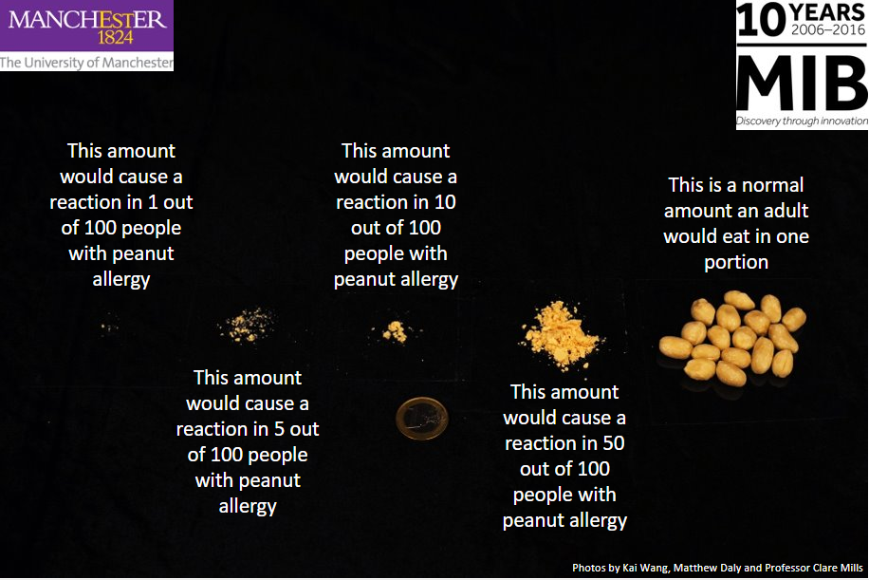


Slide 3
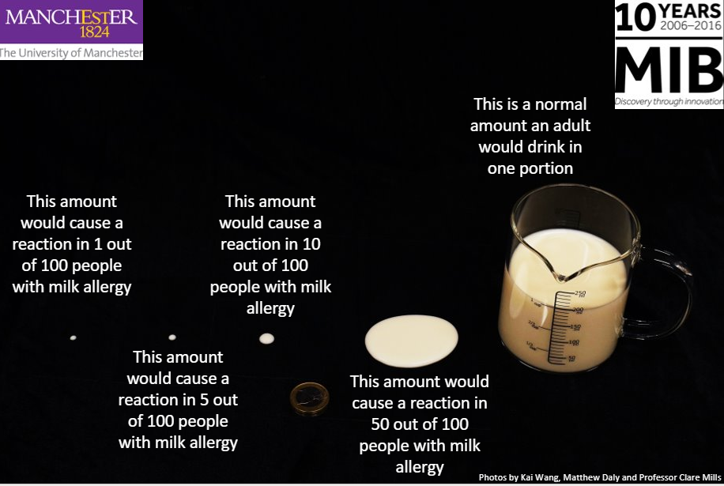

Slide 4
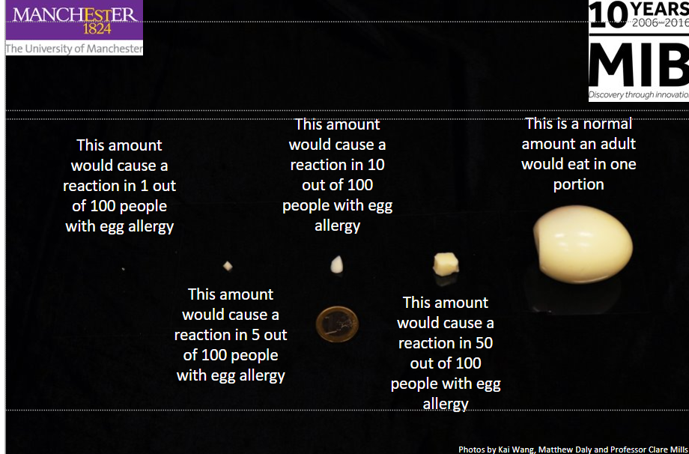

Slide 5

With thanks to:
Kai Wang, Matthew Daly and Professor Clare Mills
Manchester Institute of Biotechnology, Division of Infection, Immunity and Respiratory Medicine, Faculty of Biology, Medicine and Health, University of Manchester, Manchester, UK.

