Slide 1




All about serious allergic reactions

Slide 2



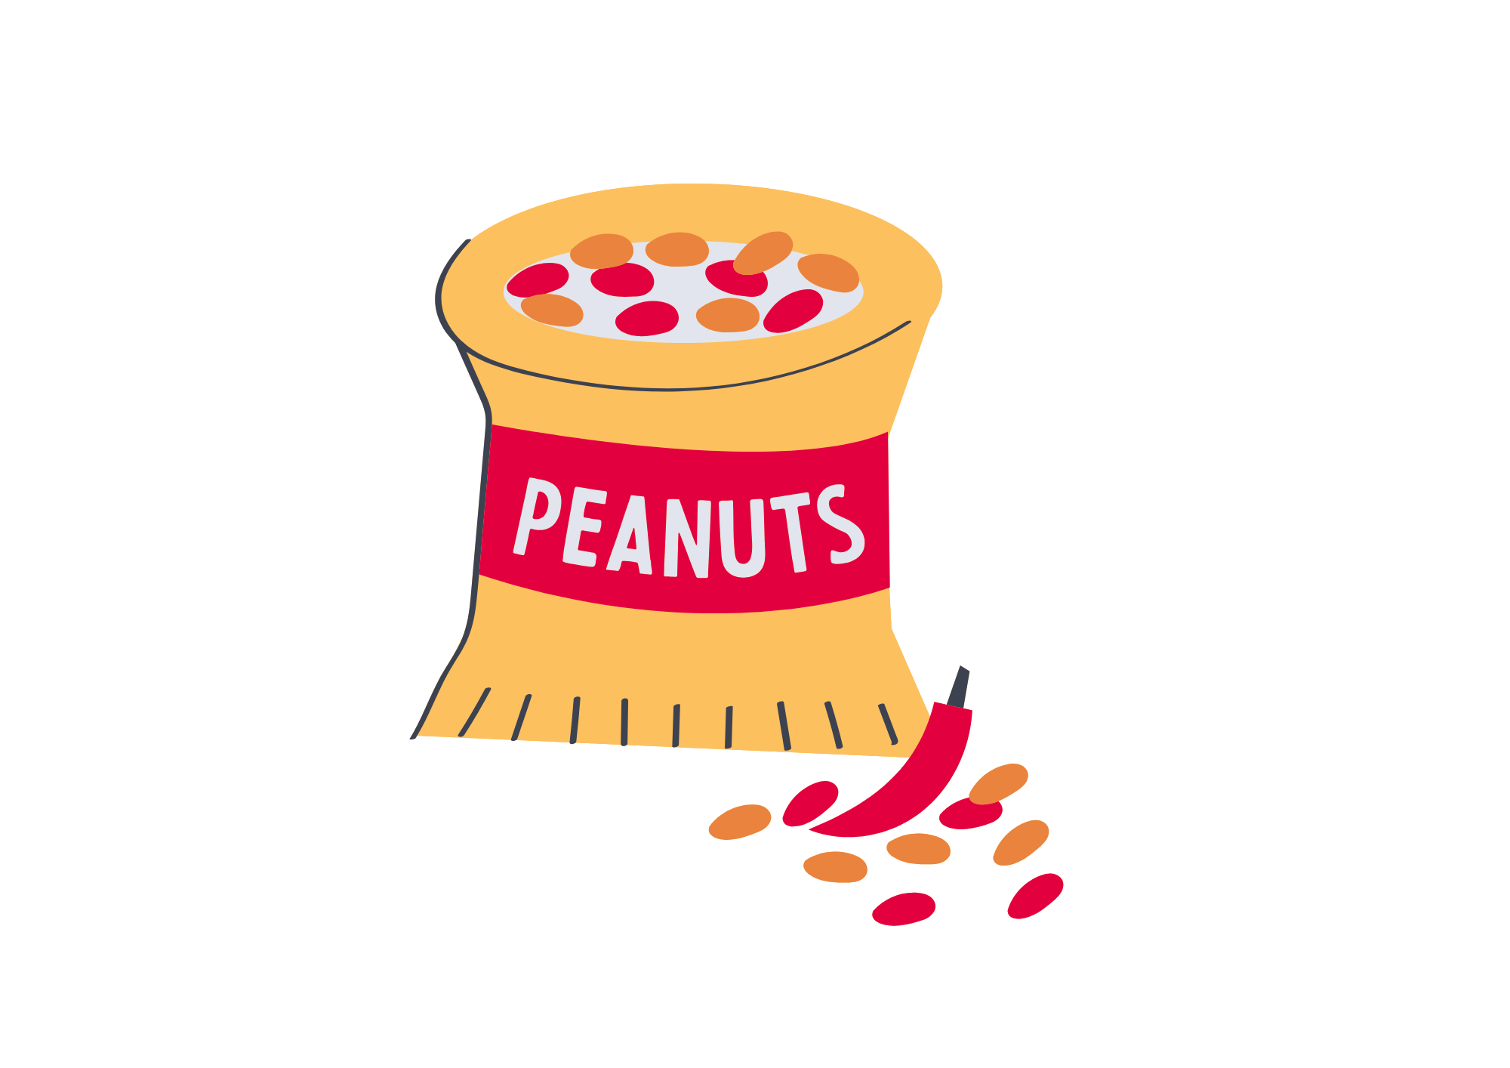

What is an allergy?
An allergic reaction happens when a person comes in contact with something, such as a food, that their body thinks will be harmful for them (called an allergen).
* This doesn’t happen to everybody, only someone with ‘allergies’.
Notes:
Talk about how your immune system helps fight illnesses and germs.
However some things that won’t hurt one person could make someone else very ill.
Talk about the different places you can find allergens in relation to the pictures.
Question to ask: How many children do you think have allergies? (Answer = Up to 5% of children are thought to have a food allergy. Every school classroom is likely to have at least one pupil with allergies.)

Slide 3

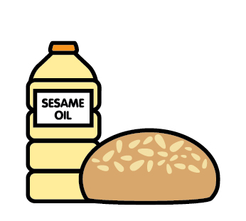



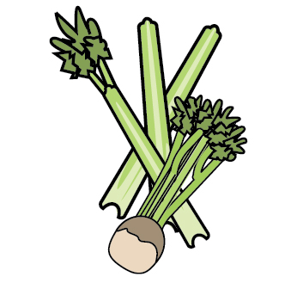
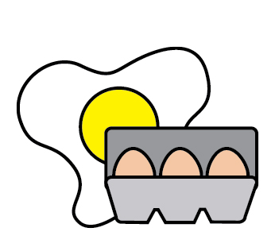



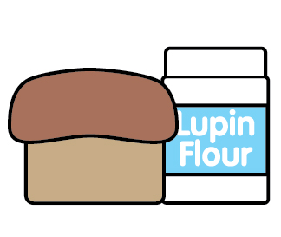
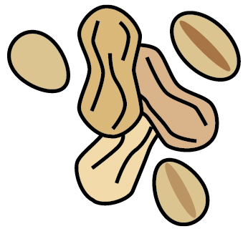


Many other foods can also cause allergic reactions. Some people can react to even tiny amounts of the food!
Top 14 food allergens
Sesame
Wheat/
Gluten
Sulphites
Tree Nuts
Molluscs
Celery
Egg
Milk
Shellfish
Soybeans
Lupin
Peanuts
Mustard
Fish
Notes:
Can the children name the different food allergens? Remember, many other foods can also cause allergic reactions.
The top 14 major food allergens in the UK are:
Celery - Cereals containing gluten - Crustaceans - Eggs- Fish - Lupin - Milk - Molluscs - Mustard – Tree Nuts - Peanuts - Sesame seeds - Soya - Sulphur dioxide/Sulphites
In the UK, food businesses must provide information about any of the 14 major allergens when they are used as ingredients in the food and drink they provide.
For more information about the 14 top food allergens: 14 Major Food Allergens | Anaphylaxis UK

Slide 4


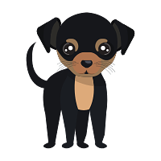
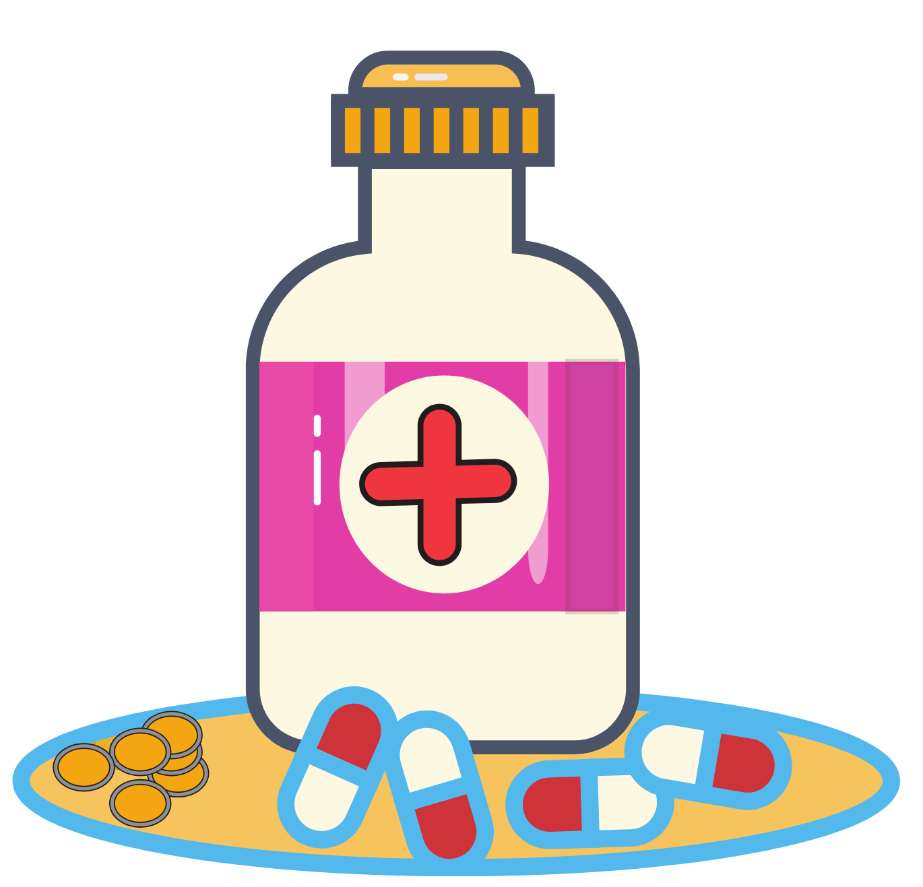

Other common allergens
Pollen
Wasps
Cats
Dogs
Medicine
Bees
Notes:
The slide shows some other common non-food allergens. Can the children name these other common allergens?

Slide 5
What is anaphylaxis?
Anaphylaxis (pronounced ana-fil-ax-is) is the most serious type of allergic reaction.
It can be life-threatening and needs emergency treatment with a medicine called ‘adrenaline’.
Notes:
For more information about anaphylaxis: About Anaphylaxis | Anaphylaxis UK

Slide 6
What are the signs of anaphylaxis?
Serious reaction (anaphylaxis) signs include:
Airway - Hard to swallow/coughing
Breathing - Difficult to breathe/noisy breathing
Circulation - Feeling dizzy, floppy or sleepy
Remember ABC!
Notes:
In extreme cases there could be a dramatic fall in blood pressure. The person may become weak and floppy and may have a sense of something terrible happening. Any of the ABC symptoms may lead to collapse and unconsciousness and, on rare occasions, can be fatal. An adrenaline auto-injector should be given without delay if any of the ‘ABC’ symptoms are present.
For more information about anaphylaxis signs and symptoms: Signs and symptoms of anaphylaxis | Anaphylaxis UK

Slide 7
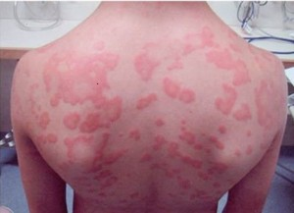
Other allergic reaction signs
Other signs can include:
Itchy skin rash
Itchy/tingling mouth
Puffy lips, face or eyes
Tummy pain or being sick
The signs above can also happen on their own. If there are no ABC signs, the allergic reaction is likely to be less serious and not anaphylaxis.
Notes:
The ABC symptoms will usually (but not always) also come with other less-serious symptoms, such as:
- a red raised rash (known as hives or urticaria) anywhere on the body
- a tingling or itchy feeling in the mouth
- swelling of lips, face or eyes
- stomach pain or vomiting.
These symptoms can also happen on their own. If you don’t have the ABC symptoms, the reaction is likely to be less serious and is not the same as anaphylaxis, but watch carefully in case ABC symptoms develop.

Slide 8
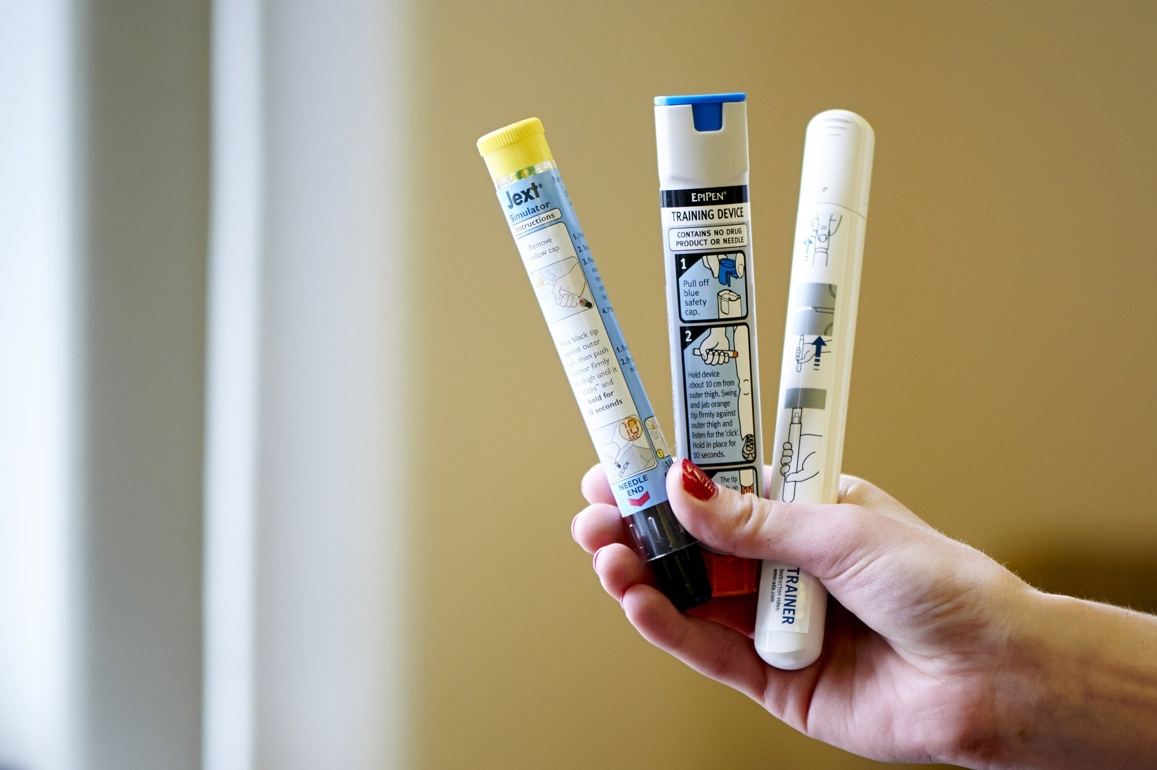
Medication
When someone has a serious allergic reaction (anaphylaxis), they have to use a medicine pen which looks like this.
It injects a medicine called ‘adrenaline’ into the top of the person’s leg to make them feel better.
These are also called adrenaline auto-injectors. There are 3 brand types in the UK (EpiPen, Emerade and Jext).
Notes:
See here for more information about adrenaline: Adrenaline | Anaphylaxis UK

Slide 9
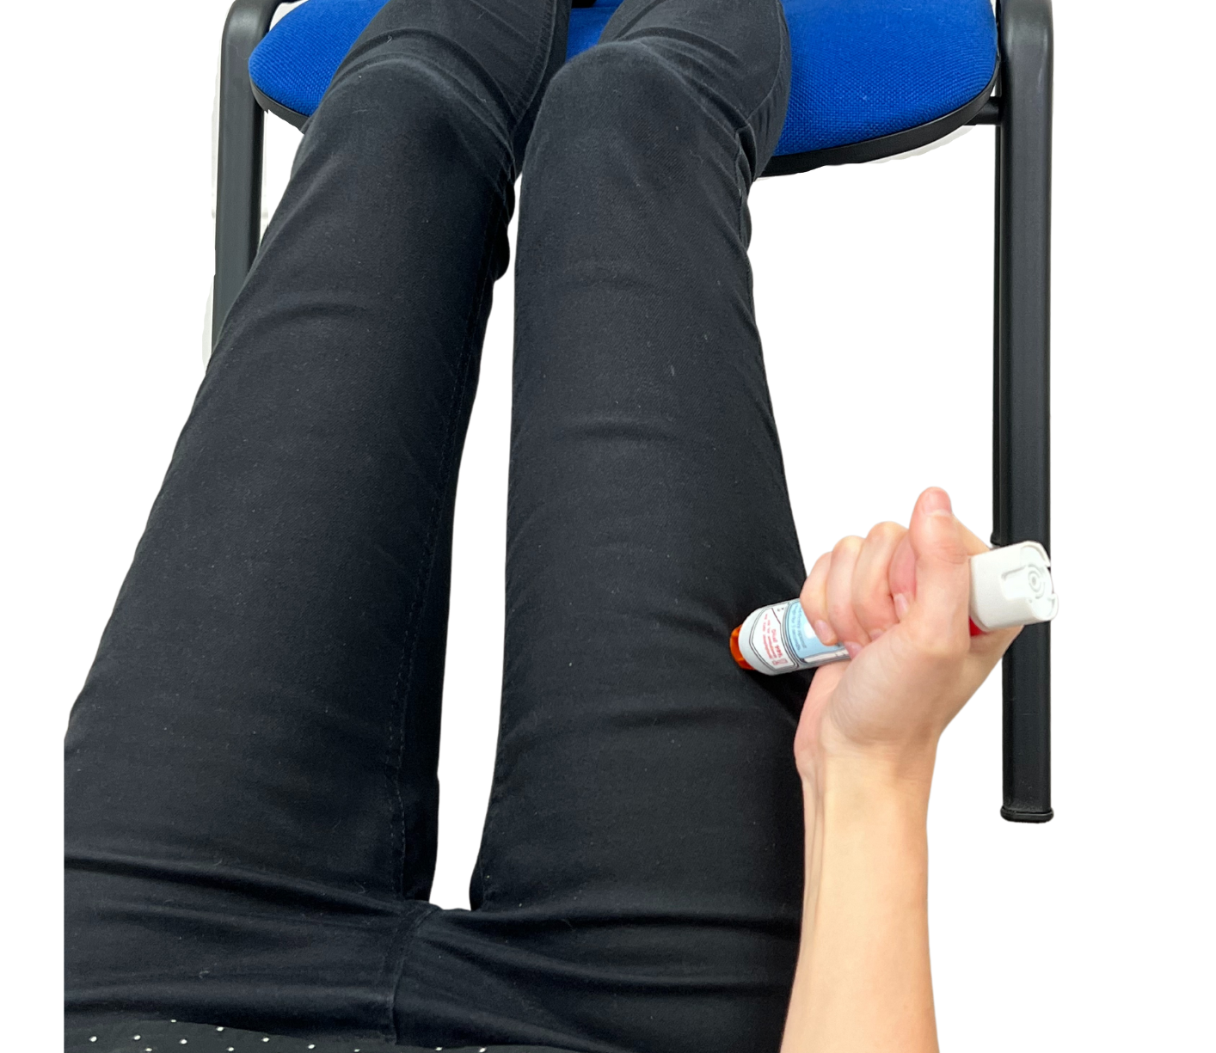
Using an adrenaline auto-injector
When an allergic reaction happens, it is important to get help quickly.
If the person has any of the ABC signs, they need to use adrenaline.
They should stay where they are and lay flat with their legs raised. If they are struggling to breathe, they may need to be propped up.
Adrenaline should be given into the muscle in the outer thigh. Always follow the instructions on the specific device.
Notes:
For more information about what to do in an emergency: What to do in an emergency | Anaphylaxis UK
Trainer devices can be ordered for free directly from the manufacturers:
EpiPen® Training Pen | EpiPen®
Order Trainer Pen (jext.co.uk)
Order Brochures | Emerade (emerade-bausch.co.uk)

Slide 10



What does it feel like to have an allergy?
Someone with an allergy has to be careful about what they do and make sure they stay away from the thing/things that make them feel ill.
This can make people feel different or left out.
Notes:
Talk about the different situations – birthday parties, eating out, and why someone may feel like the ‘odd one out’

Slide 11
What you can do to help
If your friend has an allergy, you can:
Wash your hands to keep them clean when with your friend.
Help your friend to stay away from the things which make them ill.
Ask your friend about their allergy and how it makes them feel.
Don’t share your lunch or snacks.
Know what happens to someone when they have an allergic reaction and get help quickly if you see one happening.
Notes:
Discuss how everyone can help to keep allergic children safe.

Slide 12
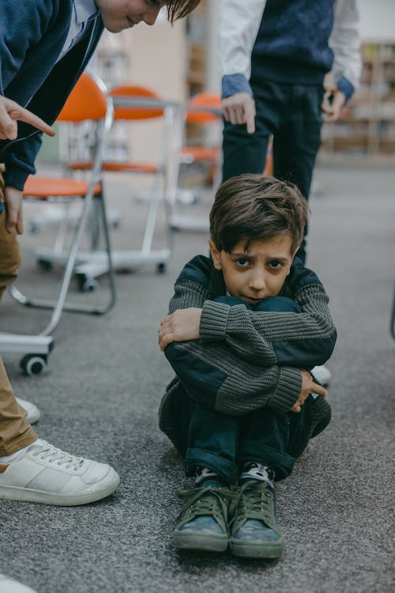
Bullying is never ok
Food allergy bullying is when someone with allergies is teased or even threatened with the foods they are allergic to
This is extremely dangerous and unsafe for the allergic person, and can even be life-threatening
Remember, anaphylaxis is a serious, life-threatening allergic reaction
Notes:
Unfortunately we hear about allergy bullying through our charity Helpline. Some recent examples include children purposely:
throwing yoghurt at a child allergic to milk
splashing milk on a child allergic to milk
hiding nuts in the pockets of a child allergic to tree nuts
Tragically, Karanbir Cheema, a 13 year-old boy allergic to milk, died in 2017 after a pupil flicked a piece of cheese at him at school.
All children need to understand the possible consequences of food allergy bullying.

Slide 13
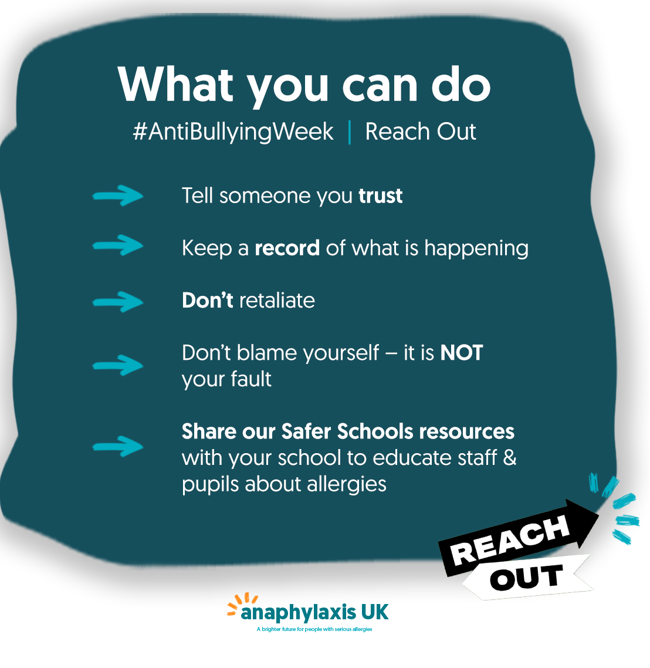
Bullying is never ok
If you’ve been bullied because of food allergies, or if you’ve seen bullying happen because of food allergies, please tell a trusted grown up.
Notes:
For our Safer Schools Programme of resources and information for schools: Safer Schools Programme | Anaphylaxis UK

Slide 14

Anaphylaxis UK is the only UK wide charity solely focused on supporting people at risk of serious allergic reactions.
Safer Schools Programme
Podcasts & Webinars
Factsheets
Helpline
AllergyWise online training
Notes:
Anaphylaxis UK Homepage | Anaphylaxis UK

