Slide 1




Allergy awareness for secondary schools

Slide 2
Welcome
What is an allergy?
Allergic reactions
Signs of a reaction
Medication
Further risks
Emotional impact
Notes:
Introduce the topics:
What is an allergy
Allergic reactions
Signs of a reaction
Medication
Further risks
Emotional impact of having a serious allergic reaction
If students have any questions then they can be asked as they go along, or, if preferred, questions can be asked at the end. If you are unsure as to how to answer a question, please refer them to the Anaphylaxis UK website and helpline service.
www.anaphylaxis.org.uk
Helpline: 01252 542029

Slide 3














What is an allergy?
An allergy is when your body reacts to things that can be harmless to others
Allergies can be caused by certain foods, animals, medicines and even pollen
Variety and severity of allergies differ from person to person
There are 14 major food allergens in the UK, and approximately 2 million people have allergies
Notes:
Beginning question
Question: How many children do you think have allergies?
(Answer = Up to 5% of children are thought to have a food allergy. Every school classroom is likely to have at least one pupil with allergies.)
Highlight that there are 14 major food allergens in the UK shown by the circular images which are (going left to right) celery, crustaceans (i.e. prawns), eggs, gluten, fish, lupin, milk, molluscs (i.e. mussels), mustard, tree nuts (i.e. almonds), peanuts, sesame, soybeans and sulphites.
Can they name the different food allergens? Remember, many other foods can also cause allergic reactions.
The top 14 major food allergens in the UK are:
Celery - Cereals containing gluten - Crustaceans - Eggs- Fish - Lupin - Milk - Molluscs - Mustard – Tree Nuts - Peanuts - Sesame seeds - Soya - Sulphur dioxide/Sulphites
In the UK, food businesses must provide information about any of the 14 major allergens when they are used as ingredients in the food and drink they provide.
For more information about the 14 top food allergens: 14 Major Food Allergens | Anaphylaxis UK

Slide 4
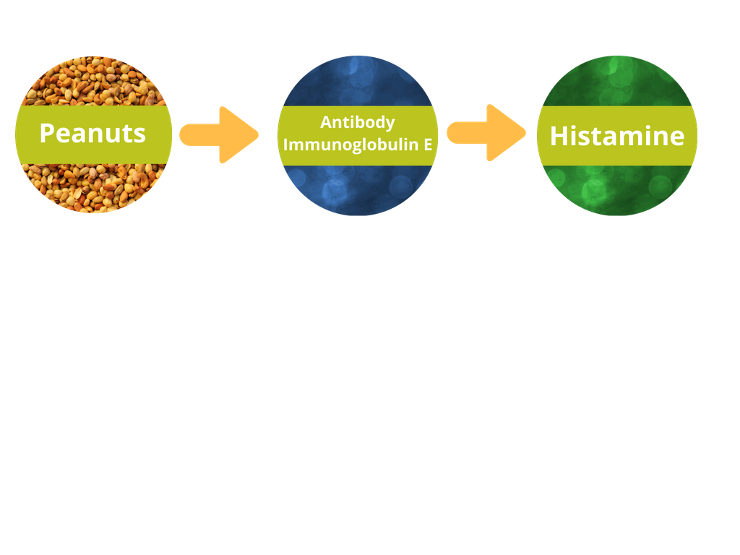


Allergic reactions
An allergic reaction happens when the person comes into contact with their allergen
Allergen
Antibody Immunoglobulin E
Histamine
Allergic reactions vary from mild to serious depending on the person and allergen
Anaphylaxis (pronounced ana-fil-ax-is) is the most serious type of allergic reaction
Notes:
Any allergic reaction, including the most serious form, anaphylaxis, occurs when the body’s immune system wrongly identifies a food or substance as a threat.
Allergic reactions are caused by the sudden release of chemicals, including histamine, from cells in the body. The release is triggered by the reaction between the immune system antibodies (called Immunoglobulin E or IgE) and the food or substance (known as an allergen) it has been exposed to.
The body will have been exposed to the allergen on a previous occasion, although the person may not have been aware of this at the time. On that earlier occasion, the allergen was wrongly identified as a threat and antibodies were made against it, which means that on the next exposure, a serious reaction may occur.
The mechanism is so sensitive that sometimes even tiny amounts of the allergen can cause an allergic reaction.

Slide 5

What is anaphylaxis?
Anaphylaxis is a serious allergic reaction affecting the whole body
The reaction usually comes on quickly, often within minutes of exposure to the allergen, but sometimes it can be hours later. Causes often include foods, insect stings, or medicines
The immune system is so sensitive that tiny amounts of the allergen can cause a reaction
Anaphylaxis can be life-threatening and needs emergency treatment with a medicine called ‘adrenaline’.
The term comes from the Greek words ana (against) and phylaxis (protection)
Notes:
For more information about anaphylaxis: About Anaphylaxis | Anaphylaxis UK

Slide 6

What to look for
Serious allergic reaction (anaphylaxis) signs include:
Airway: swelling in the throat, tongue or upper airways (tightening of the throat, hoarse voice, difficulty swallowing).
Breathing: sudden onset wheezing, breathing difficulty, noisy breathing.
Circulation: dizziness, feeling faint, sudden sleepiness, tiredness, confusion, pale clammy skin, loss of consciousness.
A
B
C
Any one or more of the above symptoms may be present.
Remember ABC!
Notes:
Any one or more of the above symptoms may be present – these are often referred to as the ABC symptoms.
In extreme cases there could be a dramatic fall in blood pressure. The person may become weak and floppy and may have a sense of something terrible happening. Any of the ABC symptoms may lead to collapse and unconsciousness and, on rare occasions, can be fatal. An adrenaline auto-injector should be given without delay if any of the ‘ABC’ symptoms are present.
Ensure students know where to get help if their friend is having a reaction at school and where their adrenaline auto-injector devices are kept. If any of these symptoms are present, get help immediately.
For more information about anaphylaxis signs and symptoms: Signs and symptoms of anaphylaxis | Anaphylaxis UK

Slide 7

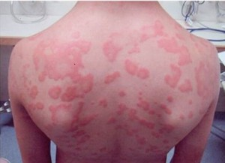
Other allergic reaction signs
Other signs can include:
Itchy skin rash
Itchy/tingling mouth
Puffy lips, face or eyes
Stomach pain or being sick
The signs above can also happen on their own. If there are no ABC signs, the allergic reaction is likely to be less serious and not anaphylaxis.
Notes:
The ABC symptoms will usually (but not always) also come with other less-serious symptoms, such as:
- a red raised rash (known as hives or urticaria) anywhere on the body
- a tingling or itchy feeling in the mouth
- swelling of lips, face or eyes
- stomach pain or vomiting.
These symptoms can also happen on their own. If you don’t have the ABC symptoms, the reaction is likely to be less serious and is not the same as anaphylaxis, but watch carefully in case ABC symptoms develop.

Slide 8

Other signs
Skin changes on their own are not a sign of anaphylaxis, and in some cases don’t occur at all
Some people may suddenly collapse or become unconscious
Other allergic reaction signs can include stomach pain, nausea, being sick
Some people also have strong feelings of impending doom

Slide 9
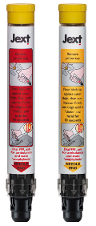
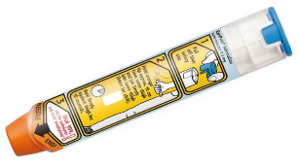

Treatment
Internationally, adrenaline is known as epinephrine
When someone has a serious allergic reaction (anaphylaxis) they need adrenaline,
it starts to work within seconds
Adrenaline is prescribed in the form of adrenaline auto-injectors, which inject adrenaline into the thigh muscle of the leg
EpiPen, Emerade and Jext are three brands of adrenaline auto-injector prescribed in the UK
Anaphylaxis can come on very quickly, so treatment must be given QUICKLY
What does adrenaline do?
It opens up your airways
It stops swelling
It raises your blood pressure
EpiPen
Emerade
Jext
Notes:
Adrenaline reverses the symptoms of anaphylaxis. See here for more information about adrenaline: Adrenaline | Anaphylaxis UK

Slide 10
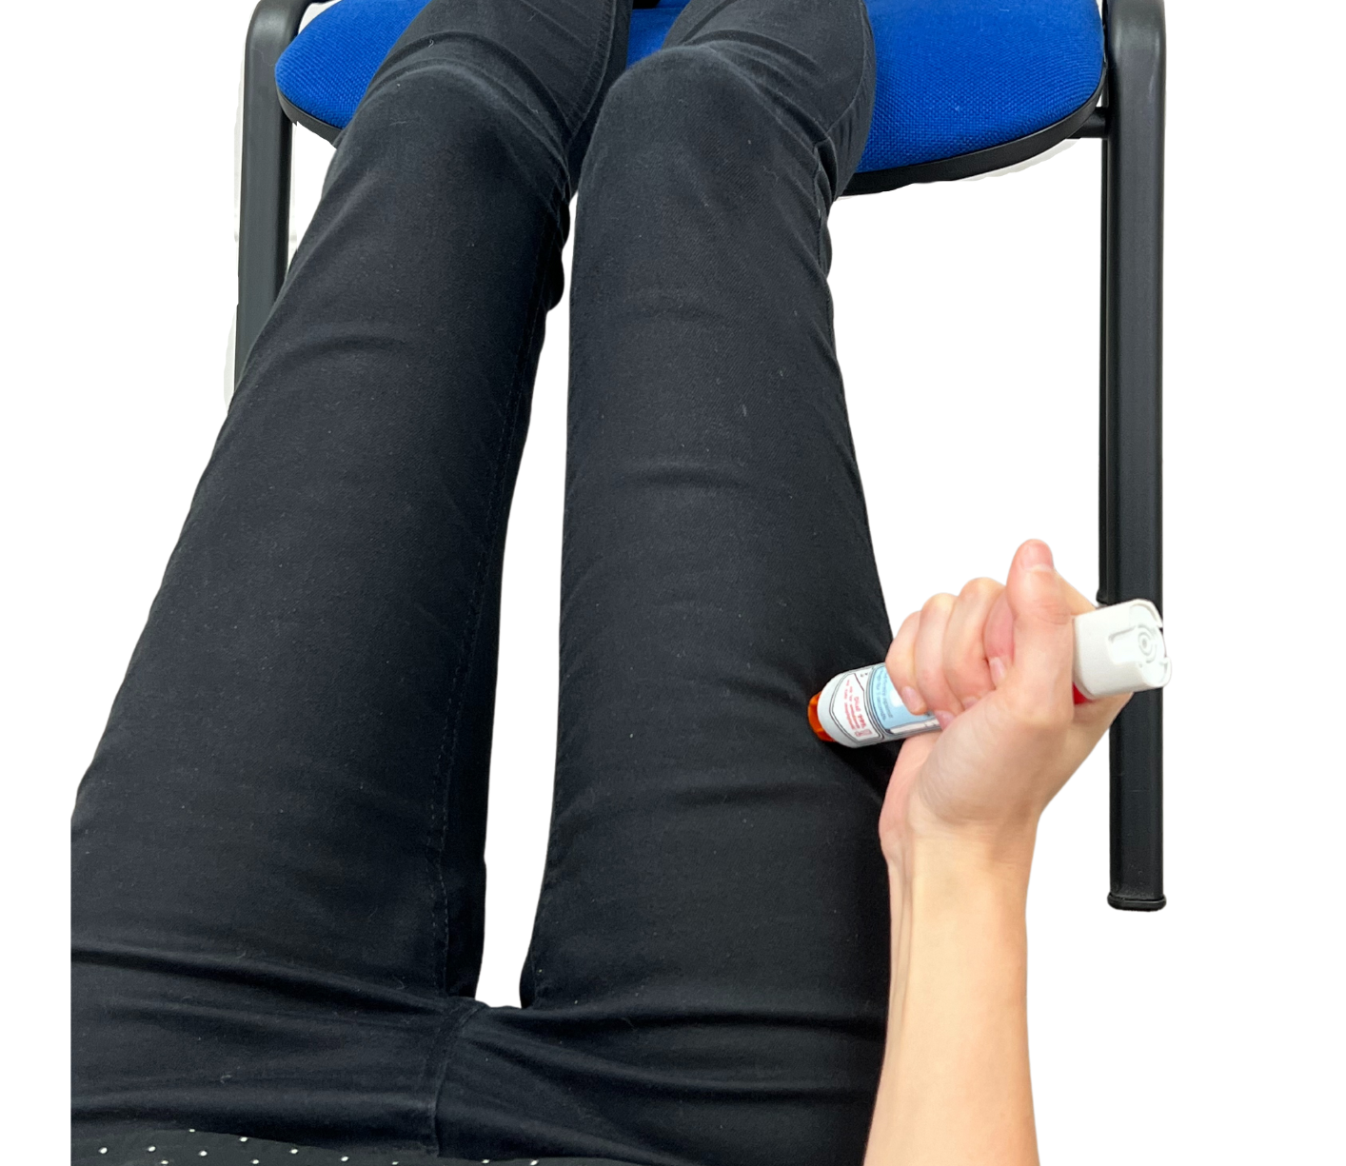

Using an adrenaline auto-injector
When an allergic reaction happens, it is important to get help quickly.
If the person has any of the ABC signs, they need to use adrenaline.
They should stay where they are and lay flat with their legs raised. If they are struggling to breathe, they may need to be propped up.
Adrenaline should be given into the muscle in the upper, outer thigh. Always follow the instructions on the specific device.
After adrenaline is used, call 999 and say this is an emergency case of anaphylaxis.
Administration of the adrenaline auto-injector device differs depending on the brand, please see videos for further instruction (links on next slide)
Notes:
For more information about what to do in an emergency: What to do in an emergency | Anaphylaxis UK
Trainer devices can be ordered for free directly from the manufacturers:
EpiPen® Training Pen | EpiPen®
Order Trainer Pen (jext.co.uk)
Order Brochures | Emerade (emerade-bausch.co.uk)

Slide 11
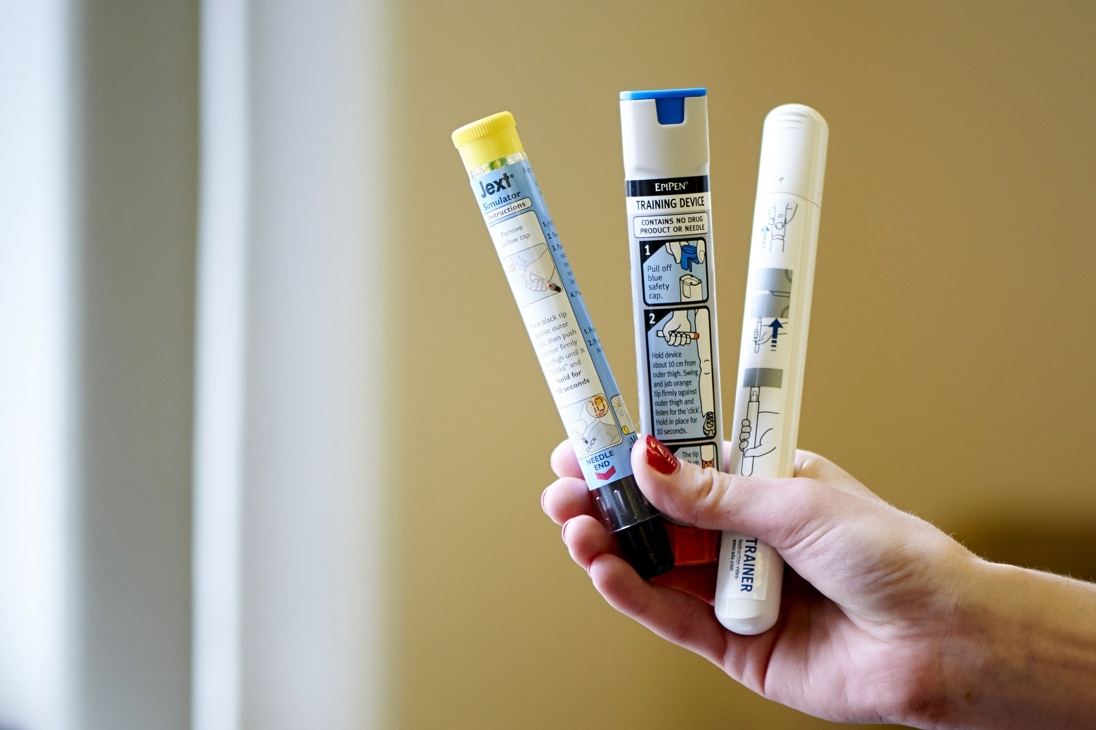
How to use an adrenaline auto-injector
Click on the links below to watch how to use each of the three different auto-injectors.
Jext: https://teens.jext.co.uk/about-jext/how-to-use/
Emerade: https://www.emerade.com/instruction-video
EpiPen: http://www.epipen.co.uk/demonstrationvideo/
Notes:
Each link takes you to the websites dedicated to each device. You may need to scroll down the page to find the video. Click on the full screen button on the bottom right hand side of each video to enlarge it.
It is recommended that all videos are played so students learn how each device works as administration differs between them.

Slide 12
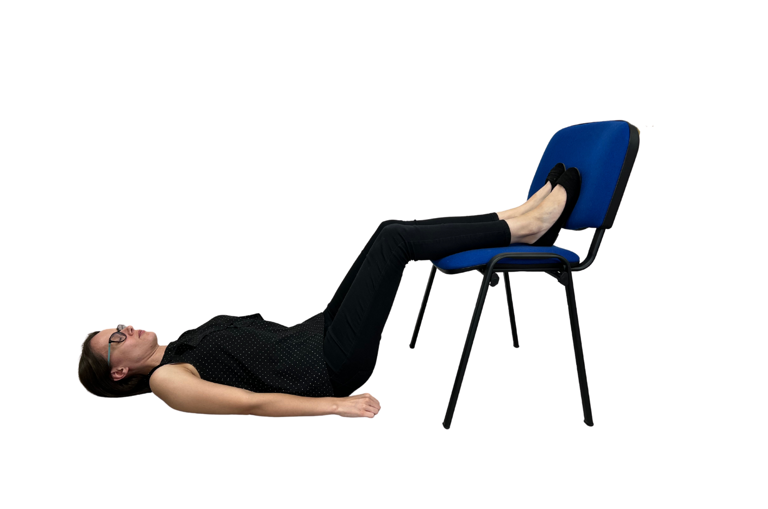
Patient positioning
A person showing any signs of anaphylaxis must stay where they are. They should lie flat with their legs raised to help blood flow back to their heart and vital organs.
If symptoms are affecting the airway (breathing), they may need to be propped up to feel more comfortable, but this should be for as short a time as possible.
If the person is unconscious they should be placed in the recovery position.
Notes:
The person must avoid any sudden change in posture after adrenaline is administered. Whilst waiting for the ambulance they must not stand up, or sit in a chair, even if they are feeling better. This could lower their blood pressure drastically, and worsen their condition, potentially fatally.

Slide 13





Further risks
Kissing - allergens can remain in the saliva for several hours – anywhere between 2 and 24 hours and even brushing teeth before kissing may not get rid of them effectively. If you have an allergy, always check with the other person if they have eaten food you may be allergic to.
Alcohol and certain medicines, such as non-steroidal anti-inflammatory drugs (e.g. aspirin and ibuprofen) can increase the severity of an allergic reaction.
Recreational drugs and alcohol may affect judgement so early signs of a reaction are not spotted and appropriate action is not taken in time.
Many people with serious allergies have asthma. Smoking is likely to make asthma worse and poorly controlled asthma can make serious allergies much more dangerous
Exercising just before or just after contact with the allergen can increase the severity of an allergic reaction.

Slide 14

Emotional impact – My life with allergies
Notes:
2-minute video of a teenager’s perspective of what life is like with allergies. Please click on the link provided on the slide to watch this video on YouTube. This is a video produced by Anaphylaxis UK. Secondary Schools Ned Interview - YouTube

Slide 15
Let’s talk about allergies
If you have an allergy
It is up to you to make your allergy known to your friends and peers – it is not embarrassing and helps to keep you safe
Let your friends and peers know where your medication is and teach them how to use it
Don’t be tempted to share food or drinks
Practice good hygiene to prevent cross contamination of allergens
Carry your adrenaline auto-injectors with you at all times

Slide 16
Let’s talk about allergies
If your friend has an allergy
Recognise the symptoms of an allergic reaction
Know how to get help
Learn how to use your friend’s adrenaline auto-injector
Be understanding – be supportive, listen and don’t be scared to ask questions
Practice good hygiene to prevent cross contamination of allergens

Slide 17
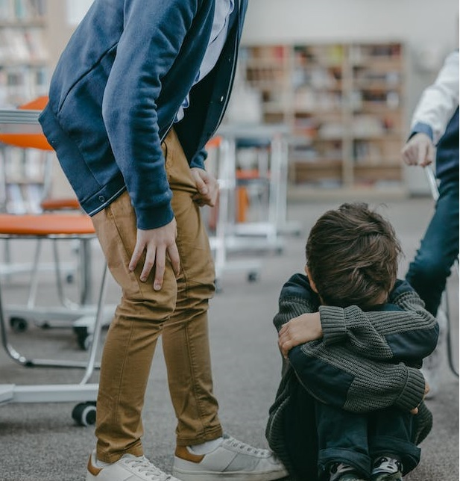
Bullying is never ok
Food allergy bullying is when someone with allergies is teased or even threatened with the foods they are allergic to
This is extremely dangerous and unsafe for the allergic person, and can even be life-threatening
Remember, anaphylaxis is a serious, life-threatening allergic reaction
Notes:
Unfortunately we hear about allergy bullying through our charity Helpline. Some examples include children purposely:
throwing yoghurt at a child allergic to milk
splashing milk on a child allergic to milk
hiding nuts in the pockets of a child allergic to tree nuts
Tragically, Karanbir Cheema, a 13 year-old boy allergic to milk, died in 2017 after a pupil flicked a piece of cheese at him at school.
All children need to understand the possible consequences of food allergy bullying.

Slide 18
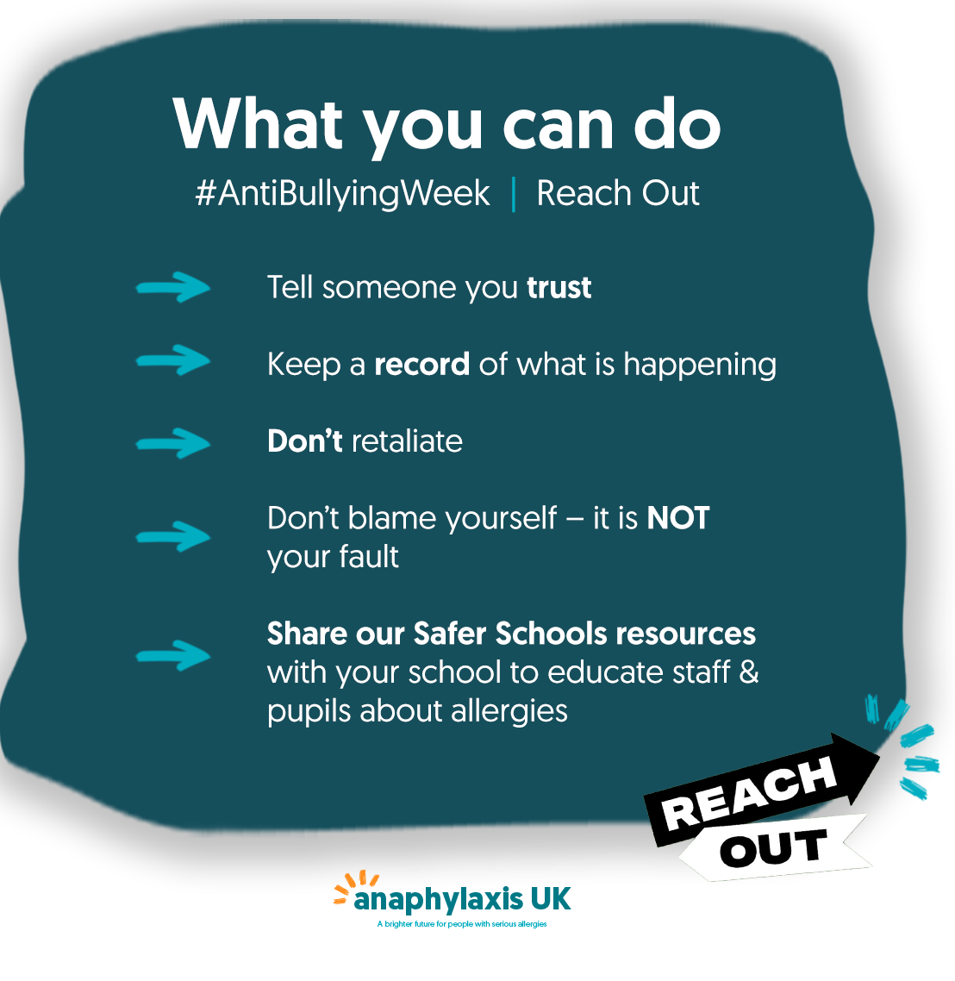
Bullying is never ok
If you’ve been bullied because of food allergies, or if you’ve seen bullying happen because of food allergies, please tell a trusted grown up.
Notes:
For our Safer Schools Programme of resources and information for schools: Safer Schools Programme | Anaphylaxis UK

Slide 19

Anaphylaxis UK is the only UK wide charity solely focused on supporting people at risk of serious allergic reactions.
Safer Schools Programme
Podcasts & Webinars
Factsheets
Helpline
AllergyWise online training
Notes:
Anaphylaxis UK Homepage | Anaphylaxis UK

